Slide 1
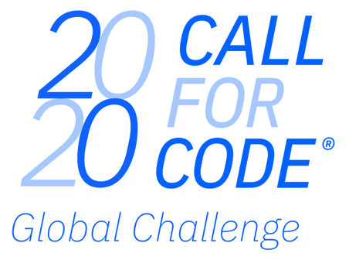

Slide 2

The Call for Code 2020 Global Challenge is a worldwide developer competition that rallies developers, visionaries and problem solvers to create practical, effective, and high-quality applications based on cloud, data and artificial intelligence that can have an immediate and lasting impact on humanitarian issues.
Two tracks, six themes:
1. COVID-19
Crisis communication during an emergency
Ways to improve remote learning
How to inspire cooperative local communities
2. Climate Change
Water sustainability
Energy sustainability
Disaster resiliency
https://developer.ibm.com/callforcode/
3

Slide 3
Crisis Communication
Technologies such as:
Chatbots
SMS
can alleviate panic in communities & provide hygienic guidance
Remote Education
Technologies such as:
Virtual classrooms
Digital courses
can continue to engage students & create interactive experiences
Community Cooperation
Technology can address:
Weather data
Supply chain data
to band communities together & identify those in most need of resources
COVID-19 Themes

Slide 4
Water sustainability
Technology can address:
Water quantity
Water quality
through data science and opensource platforms to help at personal and global scale
Energy sustainability
Technologies such as:
AI
IoT
can leverage data to pinpoint & reduce energy consumption
Disaster Resiliency
Technology can help us:
Reduce toxic exposure
Improve preparedness
by developing hardware and software solutions with machine learning capabilities
Climate Change Themes

Slide 5
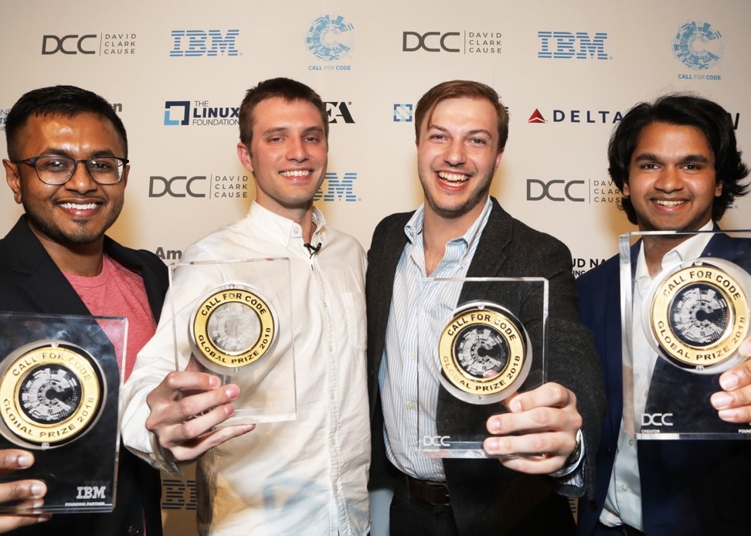

2018
A groundbreaking hardware-software solution that automatically constructs a mesh network via small Wi-Fi units allowing for sustained communications in peak times of need
Technology: IBM Watson Studio, IBM Cloud IoT Platform
https://callforcode.org/cfc-2018/
PROJECT OWL
Keeping first responders and victims connected after a natural disaster
IoT approach integrates IBM Watson Studio,
Watson Cloud APIs, and Weather Company APIs on the IBM Cloud

Slide 6
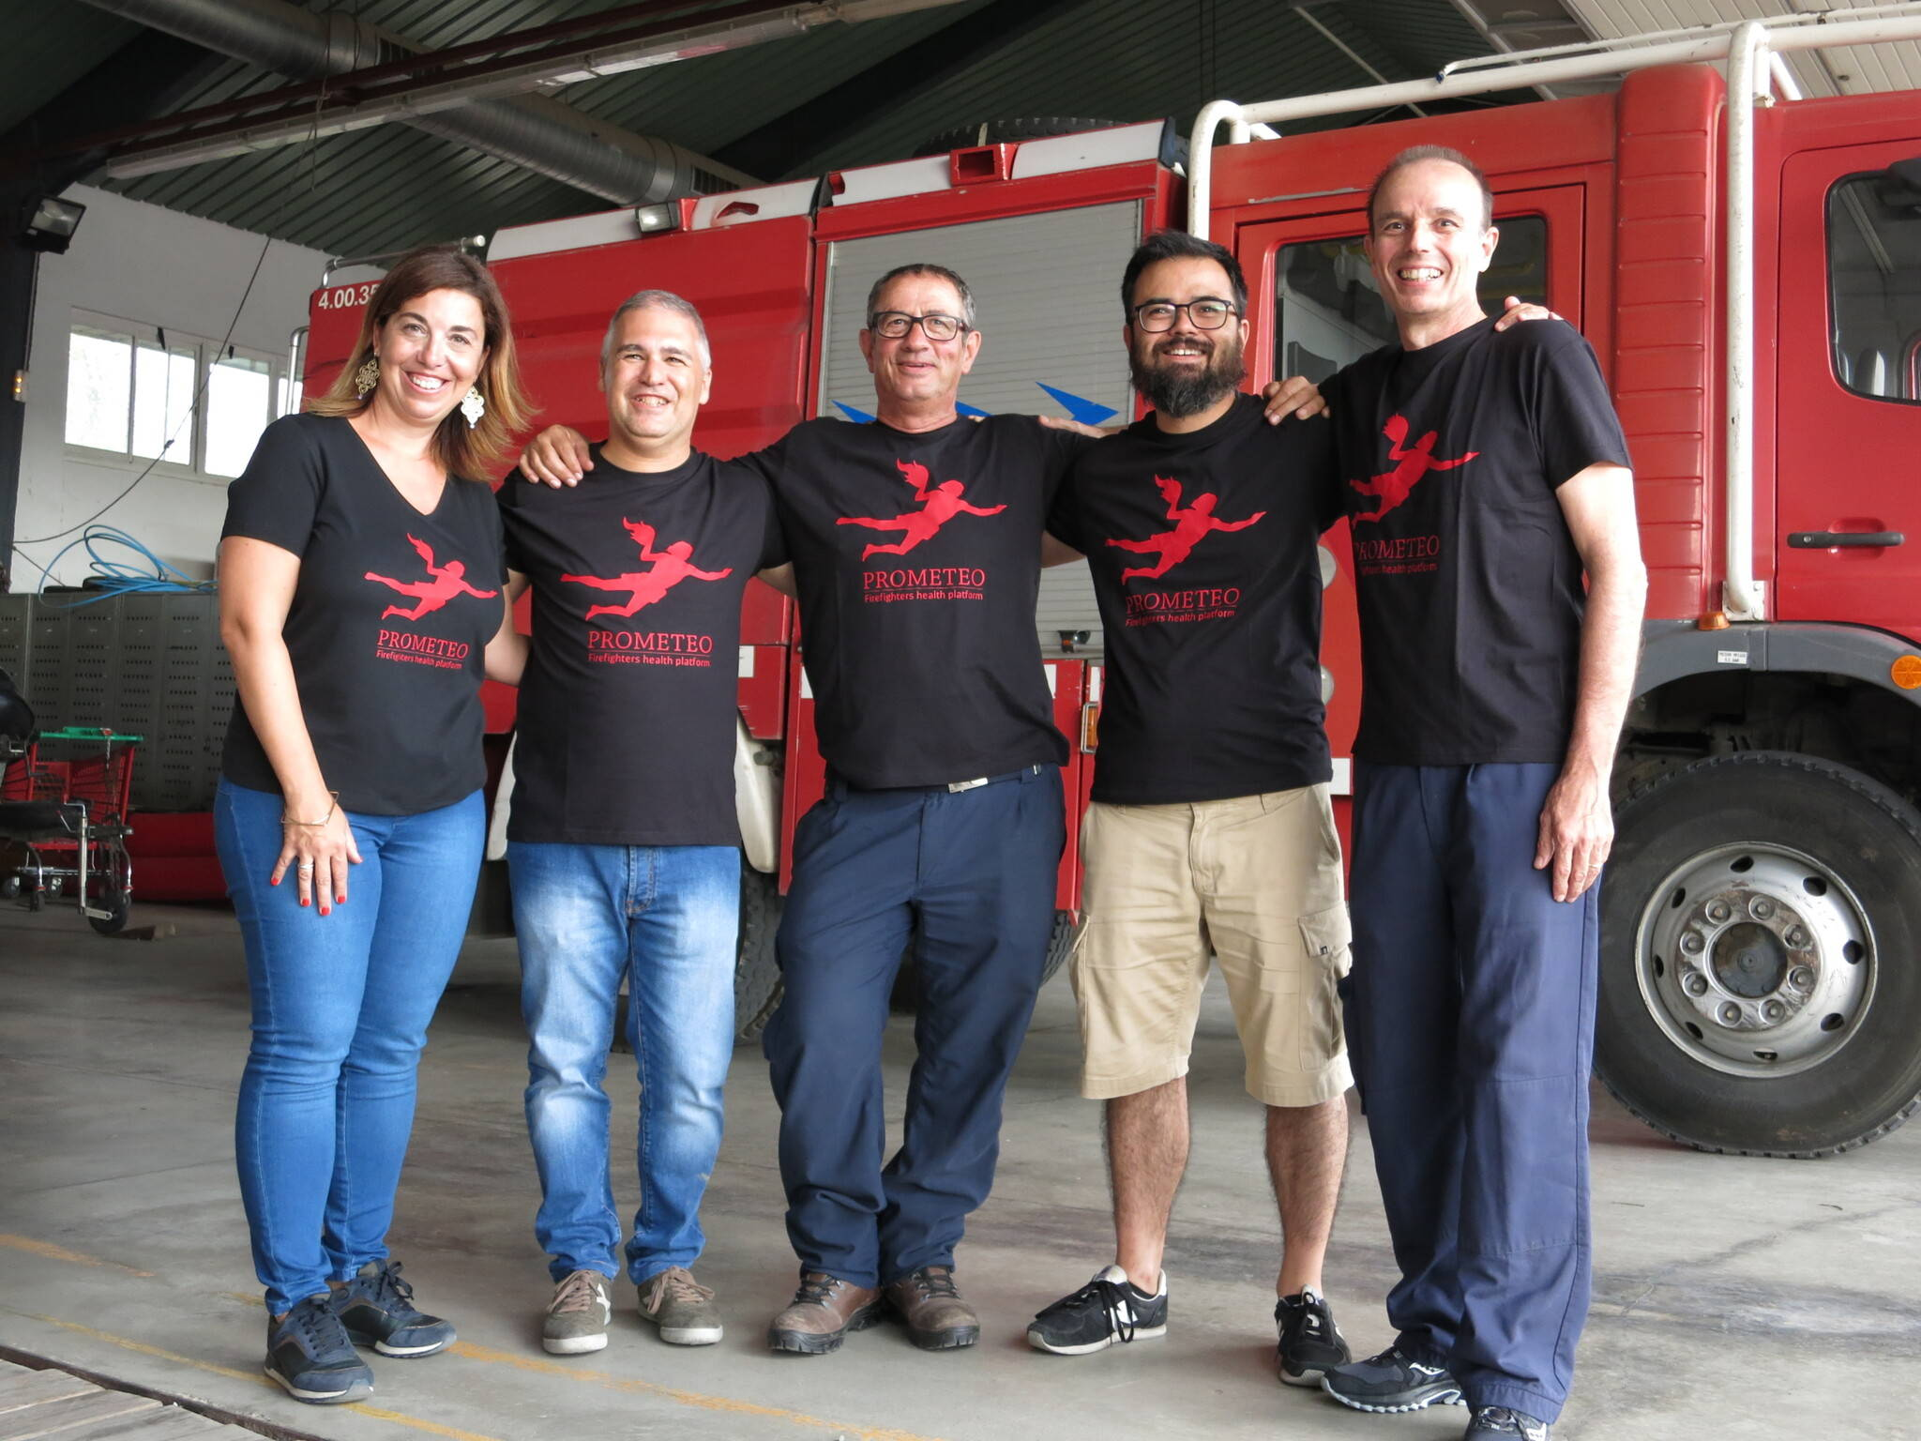
2019
A first of its kind, hardware-software solution equipped with sensors that detect toxicity levels for firefighters battling wildfires in real time, offering a transformative solution to first-responders globally
Technology: IBM Cloud IoT Platform, IBM Cloud services, Cloudant database
PROMETEO
AI-based platform to monitor and act on firefighter health and safety in real-time and over the long-term
https://developer.ibm.com/collections/cfc-2019/
An IoT Platform integrating Node-RED workflow, IBM Cloud Services like Cloudant database deployed on IBM Cloud Kubernetes Service

Slide 7
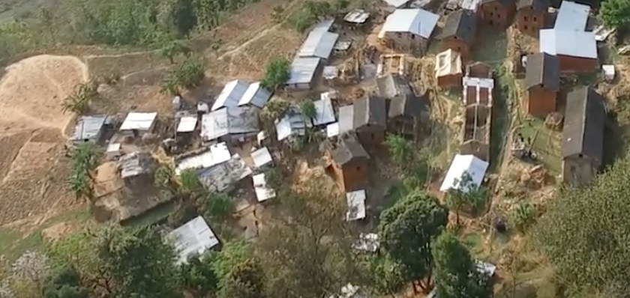
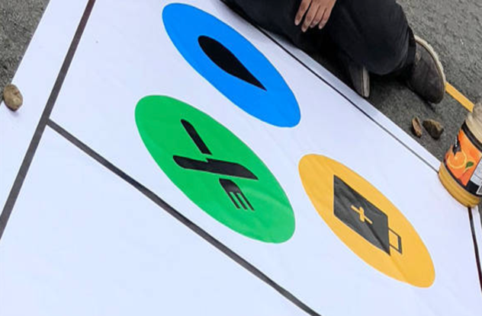
Other projects now in development…
Call for Code runner-up, P3DR
The first of its kind software solution that provides displaced families with immediate access to engineering advice following natural disaster repercussions
Technology: IBM Watson Studio, IBM Watson Visual Recognition
Receiving Linux Foundation Support
Call for Code hackathon winner, DroneAID
An intuitive hardware-software solution that gathers aid needs from stranded communities with drones powered by visual recognition allowing for clear-cut communication signals and speedy assistance
Technology: IBM Watson Studio, IBM Cloud Object Storage, IBM Watson Visual Recognition
Receiving Linux Foundation Support
https://developer.ibm.com/code-and-response/
7

Slide 8
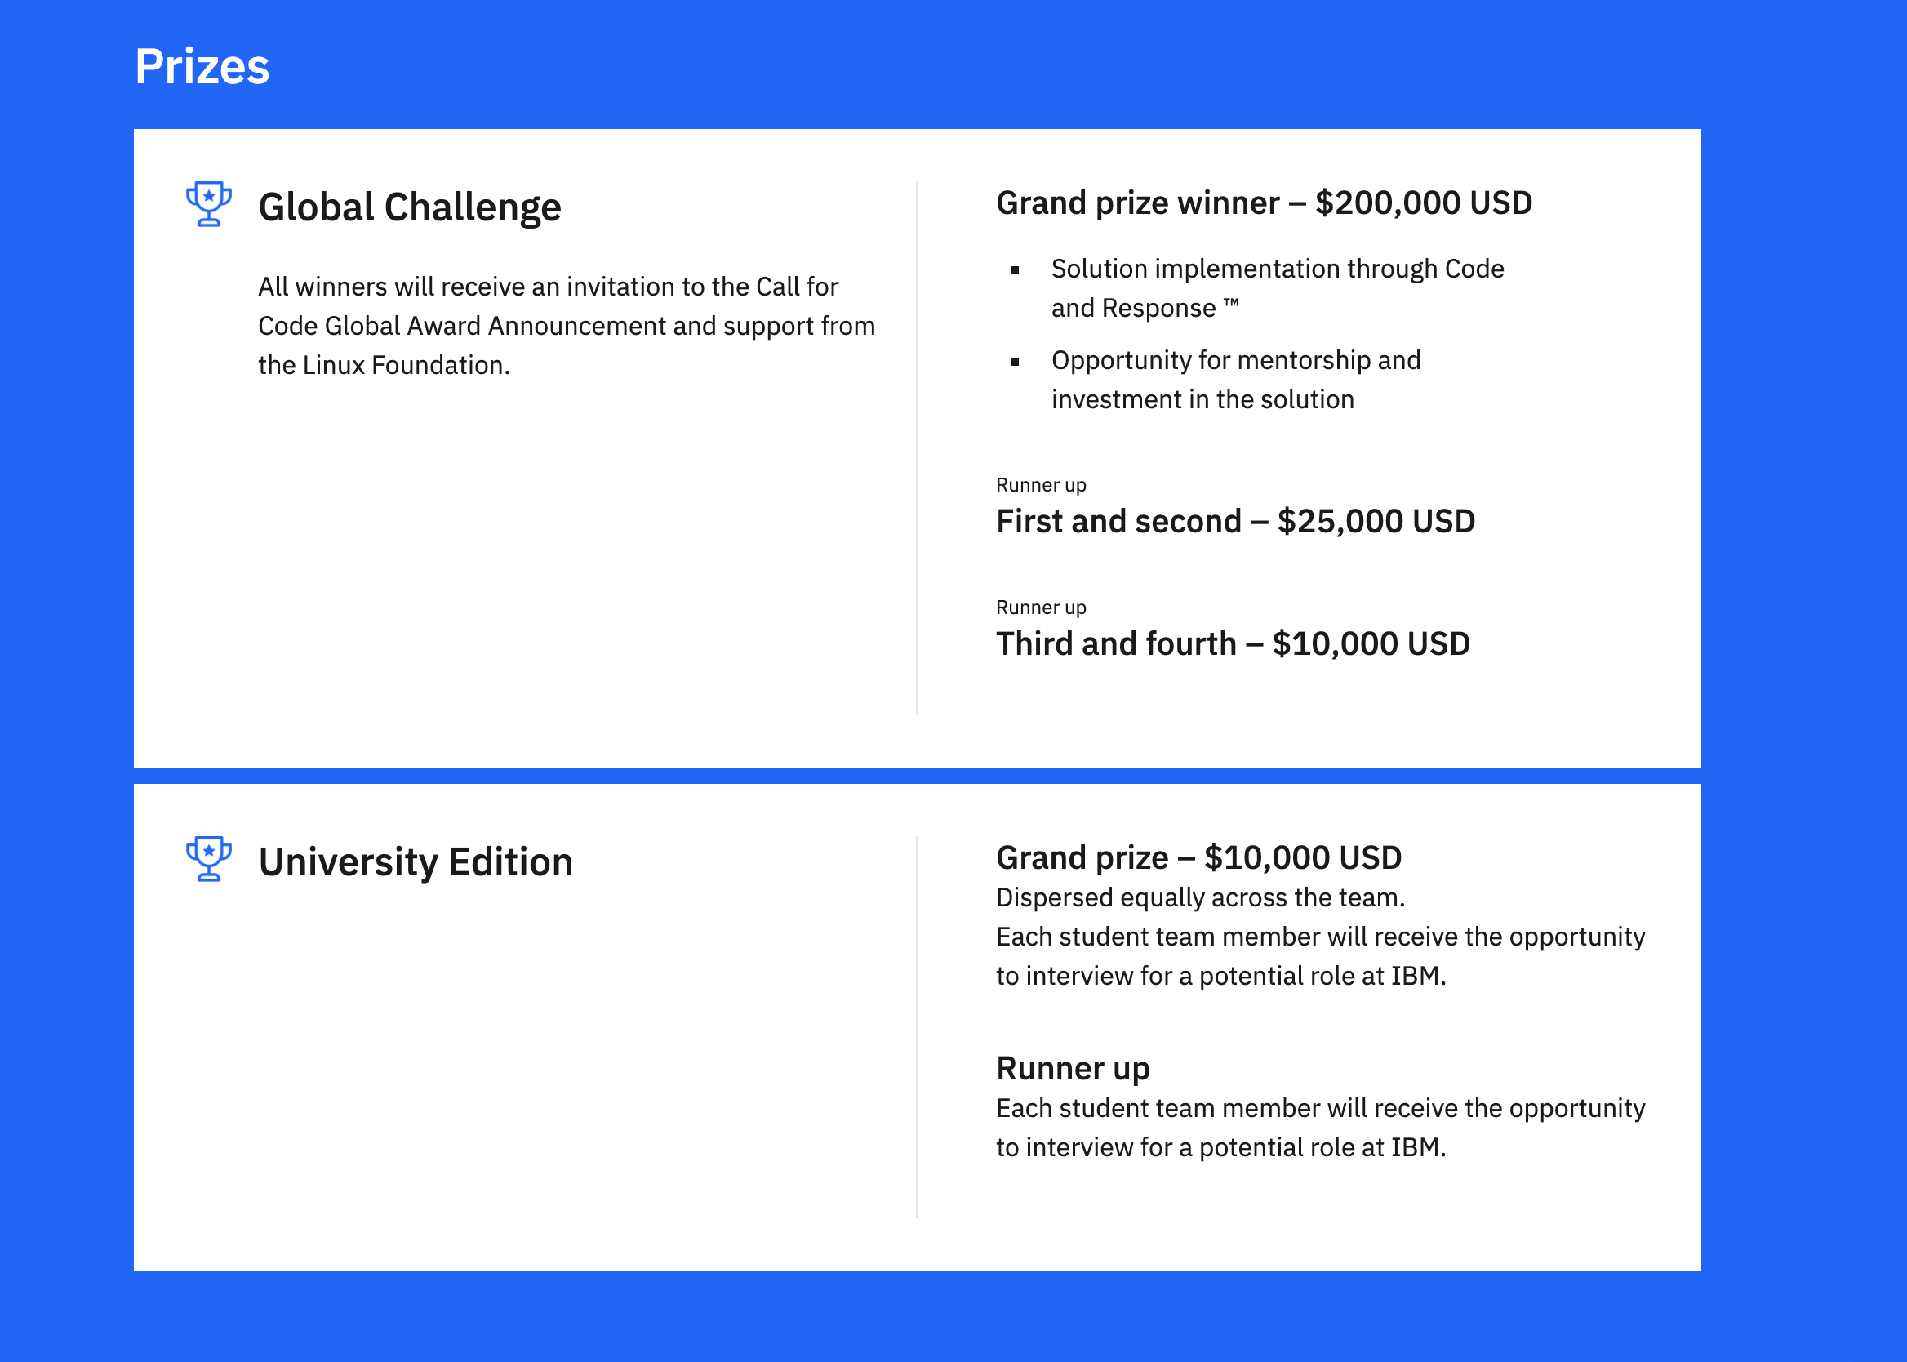
Prizes

Slide 9
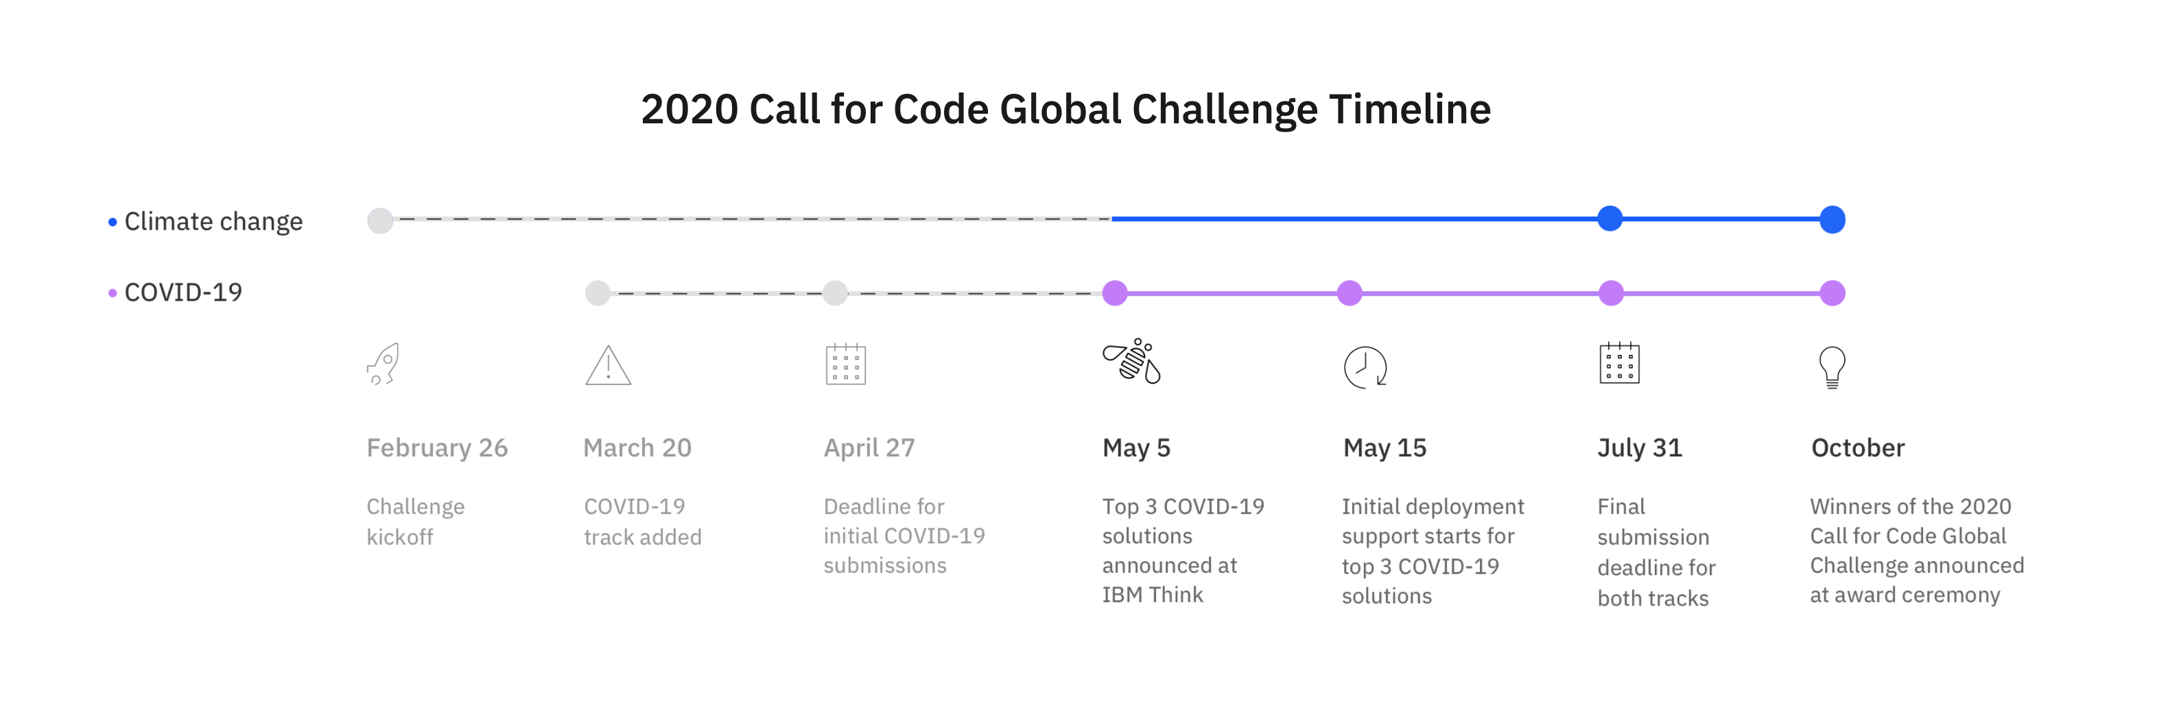
Timeline

Slide 10
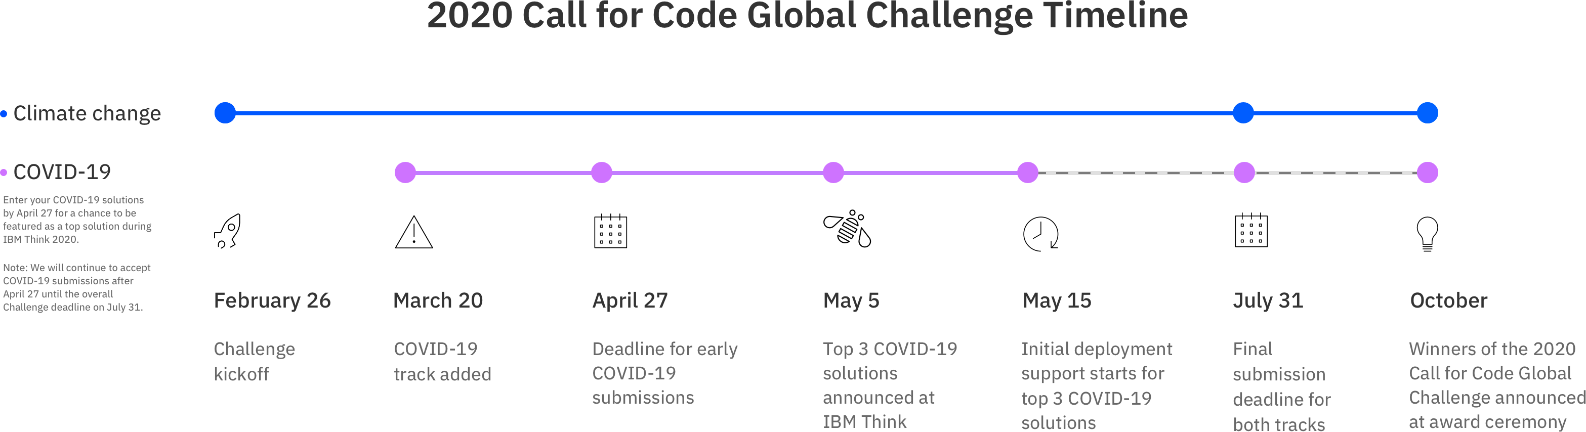
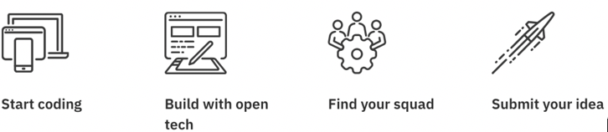
Participants: Register for the challenge, and start building
Sponsors: Show your full support with a sponsorship
COVID-19 Reference Materials
Climate Change Reference Materials
Find more details at http://ibm.biz/callforcode

Slide 11
Timeline Reference & General Guidance Around Next Steps
Registration
Step 2
Step 3
Step 4
Submission
Join the Call Accept the challenge & Register
Network & Form teams (~4 to 5 members) & join dedicated Slack workspace
Go through Starter Kits & Technical Library
Ideate on a Call for Code – Tracks & use cases
Zero in on a problem statement.
Identify IBM Cloud services
Take part in Enablement webinars / Design thinking sessions
Draw up the solution architecture diagram.
Start Building your solution with your teams and leverage IBM Cloud services
Get dedicated One– One Mentoring for each team
Build continue to co-build your solution with your teams and leverage IBM Cloud services
Short Video – summing up your solution
Final validation and idea scope expansion
Submit - Initial submission deadline.
GitHub code repository, video, slides etc.
Developer Advocacy team can help you
Constant IBM Mentoring
Continuous mentoring
Best Practice : Kindly start at the earliest. The later you start you will notice time will become a constraint and you may also not be able to relate to some “open for all” mentoring sessions we may be running for most of the audience who may be in “Step 3/4/5” because you are still at Step 1 or 2. Not to mention, this is a Global Challenge and time is an “important” factor for winning.

Slide 12
Starter kits consist of videos, graphics, written materials and code
They address: - The problem statement - Use cases - A description of the team’s solution - An architectural diagram - A tutorial with starter code
- Data sets
- Documentation and other reference materials
What is a Starter Kit?
Some developers know what they want to build in challenges like Call for Code, but for those that don't, there are starter kits. These quick start guides help developers understand the scope of the problems and start building applications tied to easy-to-understand use cases in a matter of minutes.
COVID-19 track - https://developer.ibm.com/callforcode/get-started/covid-19/#starter-kits
Climate Change track - https://developer.ibm.com/callforcode/get-started/climate-change/

Slide 13

KEY RULES
ACCEPT THE PARTICIPATION AGREEMENT
All team members must have accepted the 2020 Participation Agreement for their submissions to be eligible
COMPETE ALONE OR AS PART OF A TEAM
Teams of up to five (5) participants, each at least 18 years old, are allowed.
A participant may not be part of multiple teams.
USE THE IBM CLOUD
Submissions must use one or more IBM Cloud services or IBM Systems. Use of sponsor or affiliate APIs and open source libraries is also encouraged.
Applications must be new and built for the 2020 competition, but they may use code that was open sourced and publicly available to all other participants as of February 26, 2020.
Winning teams will be subject to a code review after submissions close.

Slide 14

Judging
Four equally weighted criteria
Completeness and transferability (5 points)
How fully has the idea been implemented? Can it achieve an impact in the field? Can it be transferred elsewhere?
Effectiveness and efficiency (5 points)
Does the solution address a high priority area? Does it achieve its goal effectively and efficiently? Can it scale?
Design and usability (5 points)
How good is the design, user experience, and ease of use of the solution? How quickly can it be put to use?
Creativity and innovation (5 points)
How unique was the approach to solving a long-
standing or previously intractable problem?

Slide 15
Problem Statement
Define Problem Statement – The Bigger the Pain, the Better It Is
Imagine yourself as the customer and tell your story – Take Customer interviews
Explain why large number of customers have the same pain
Try to Use Statistics (helps in measuring the impact of problem)

Slide 16
Solution
A Simple Tag Line
What are you intending to sell to customer
What’s your Value Proposition
Use Data Points wherever feasible

Slide 17
Business Model
Explain how you are going to make money
Why Customers will use your product
Explain how the Benefits
Explain Cost Vs Benefit

Slide 18
Demo, Explain how it Works
Show, Demo your Prototype
Explain How it works

Slide 19
Summarize and Thank You
Summarize and Thank You

Slide 20
Watch Out
Watch Out for “Pitch PITFALLS”
If You are doing the Intro’s – Do it quickly
Don’t Rush and Don’t be Slow
Be Specific….. Don’t Rely on Buzz Words
Be Confident, Wear Smile
Don’t Fill the PPT with Words, its always good to have 50% White Space :-)
Visuals always appeal better than Words

Slide 21
Anatomy of 5 Minute Elevator Pitch

Slide 22

Tip #1
Understand real world problems
Call for Code 2020 is looking for solutions that have a lasting impact and bring technology to bear on real problems with sustainable solutions
Make sure you thoroughly understand the problem domain and consider whether technology can solve a particular problem
Honestly consider how effective technology can be, and make sure it doesn’t add to the problem !

Slide 23

Tip #2
Don’t re-invent the wheel
As you brainstorm the solution that you plan to build don’t forget to consider the existing tools, data sets, and APIs that already exist
Your solution will have the greatest impact if it addresses a long-standing problem that doesn’t have an existing solution. It will also be more valuable if it builds on or integrates with an existing solution such as a commercial product with an API.
It’s important to look at standards and protocols that you can implement or leverage, such as the OASIS Emergency Data Exchange Language (EDXL) formats
13

Slide 24
Tip #3
Document your source code repository
The Call for Code 2020 submission form allows you to provide information about your application in various formats; a long description, a project roadmap and a demo video.
One of the best ways to show how mature your project is and thus how it can be explored by the judges – is to create a strong README file
Search on “readme best practices” and view a few tutorials to learn how. You can also think about embedding your video or other visuals that illustrate the application in depth.
14

Slide 25
Tip #4
Invest time to create a powerful video
One of the most powerful ways to tie your entire submission together is a compelling video.
Remember our judges are people with deep levels of expertise in technology and understanding in natural disaster impact on societies.
Have the deep-dive material and full implementation details in your solution description, source-code repository and solution roadmaps.
A recommended format for the video :
45 seconds:
What exactly are you trying to solve?
How have you solved it?
1m 30s on the demo of the submission itself, full user flow
45 seconds on results and next steps
15

Slide 26
Tip #5
Double check the permissions
You will of course want to make sure that everything you submit is your team’s highest quality work, but one of the key issues we’ve seen is that permissions errors can prevent the judges from fully evaluating your code.
The simplest solution is to make your source code repository and demo video publicly viewable after the July 31st deadline. (And when publishing, the most popular license today is the Apache License, Version 2.0).
If you provide a private video, include the password with your video link. You can add it after the URL in the form field.
16

Slide 27
Submission Process

Slide 28
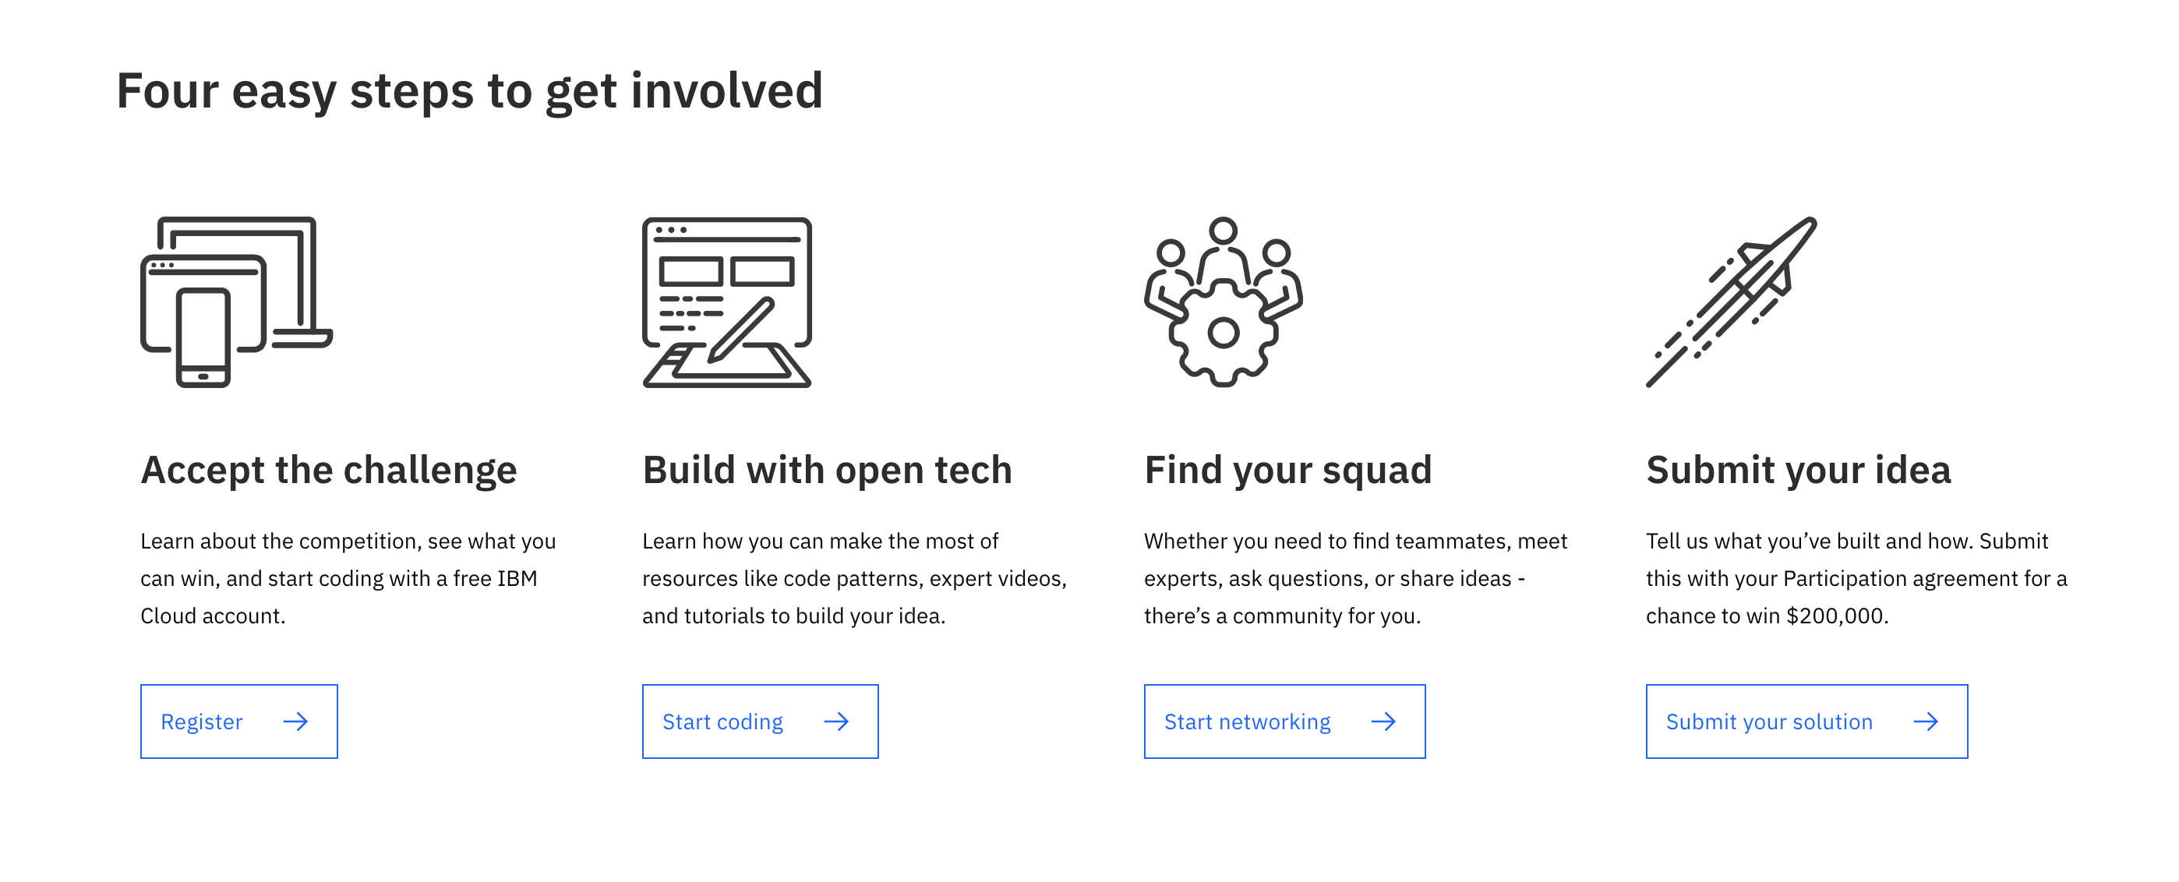
Step 1
Go to https://developer.ibm.com/callforcode/
Scroll down and click on Register

Slide 29
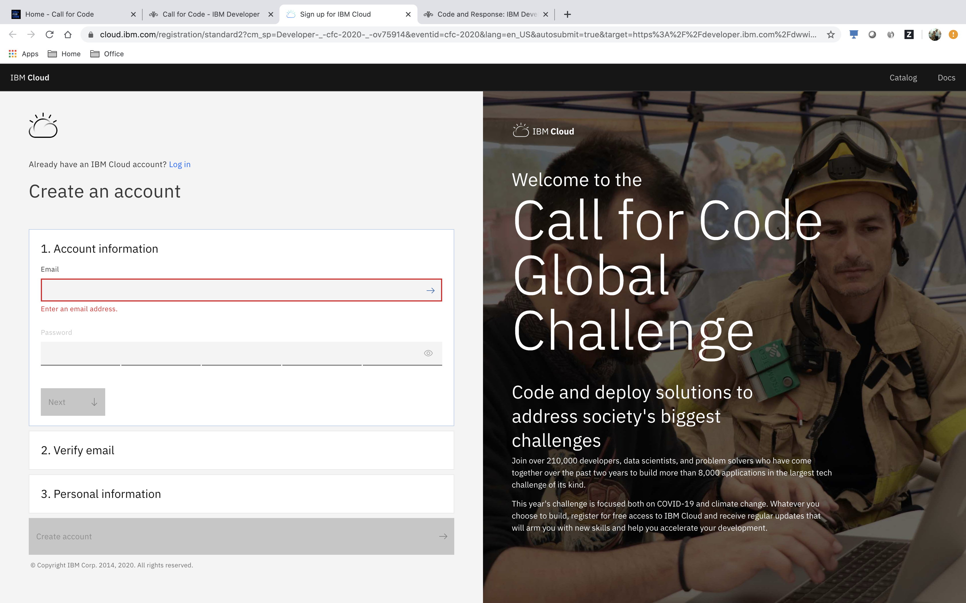
Step 2
You will be presented with an IBM Cloud login page
Create an account, if you don’t have already
You will get an email from “2020 Call for Code Global Challenge”, saying that your registration is complete

Slide 30
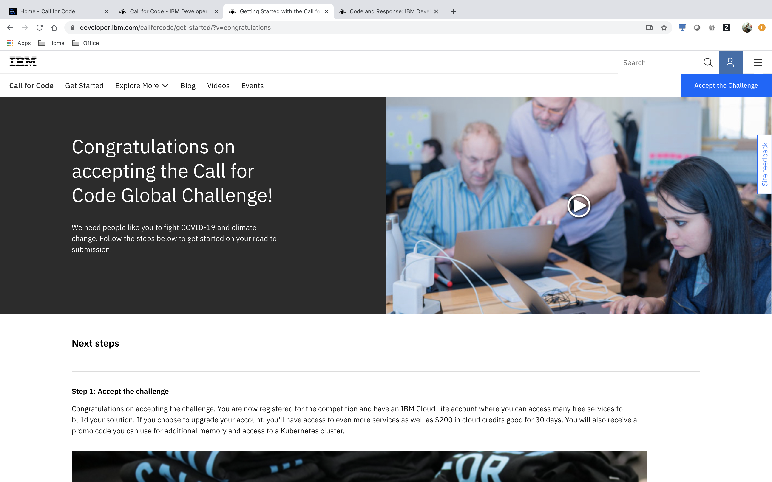
Step 3
Go through the steps given in https://developer.ibm.com/callforcode/get-started/?v=congratulations
Upgrade your account from the default Lite plan to a Paid plan if you want to make use of premium services that are not available in Lite
Choose your track – COVID-19 / Climate Change

Slide 31
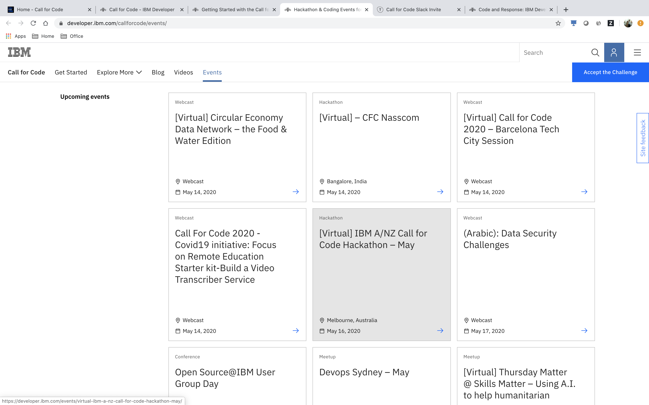
Step 4
Find Call For Code events at
https://developer.ibm.com/callforcode/events

Slide 32
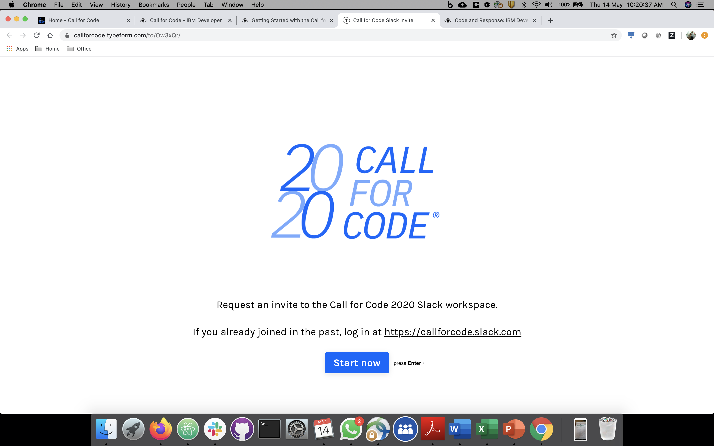
Step 5
Join the Global Slack Community - https://callforcode.typeform.com/to/Ow3xQr/
You will be presented with a Typeform. Fill in all the fields.
You will get an invite from Daniel Krook chubbychellamchinni99@gmail.com to join https://callforcode.slack.com/

Slide 33
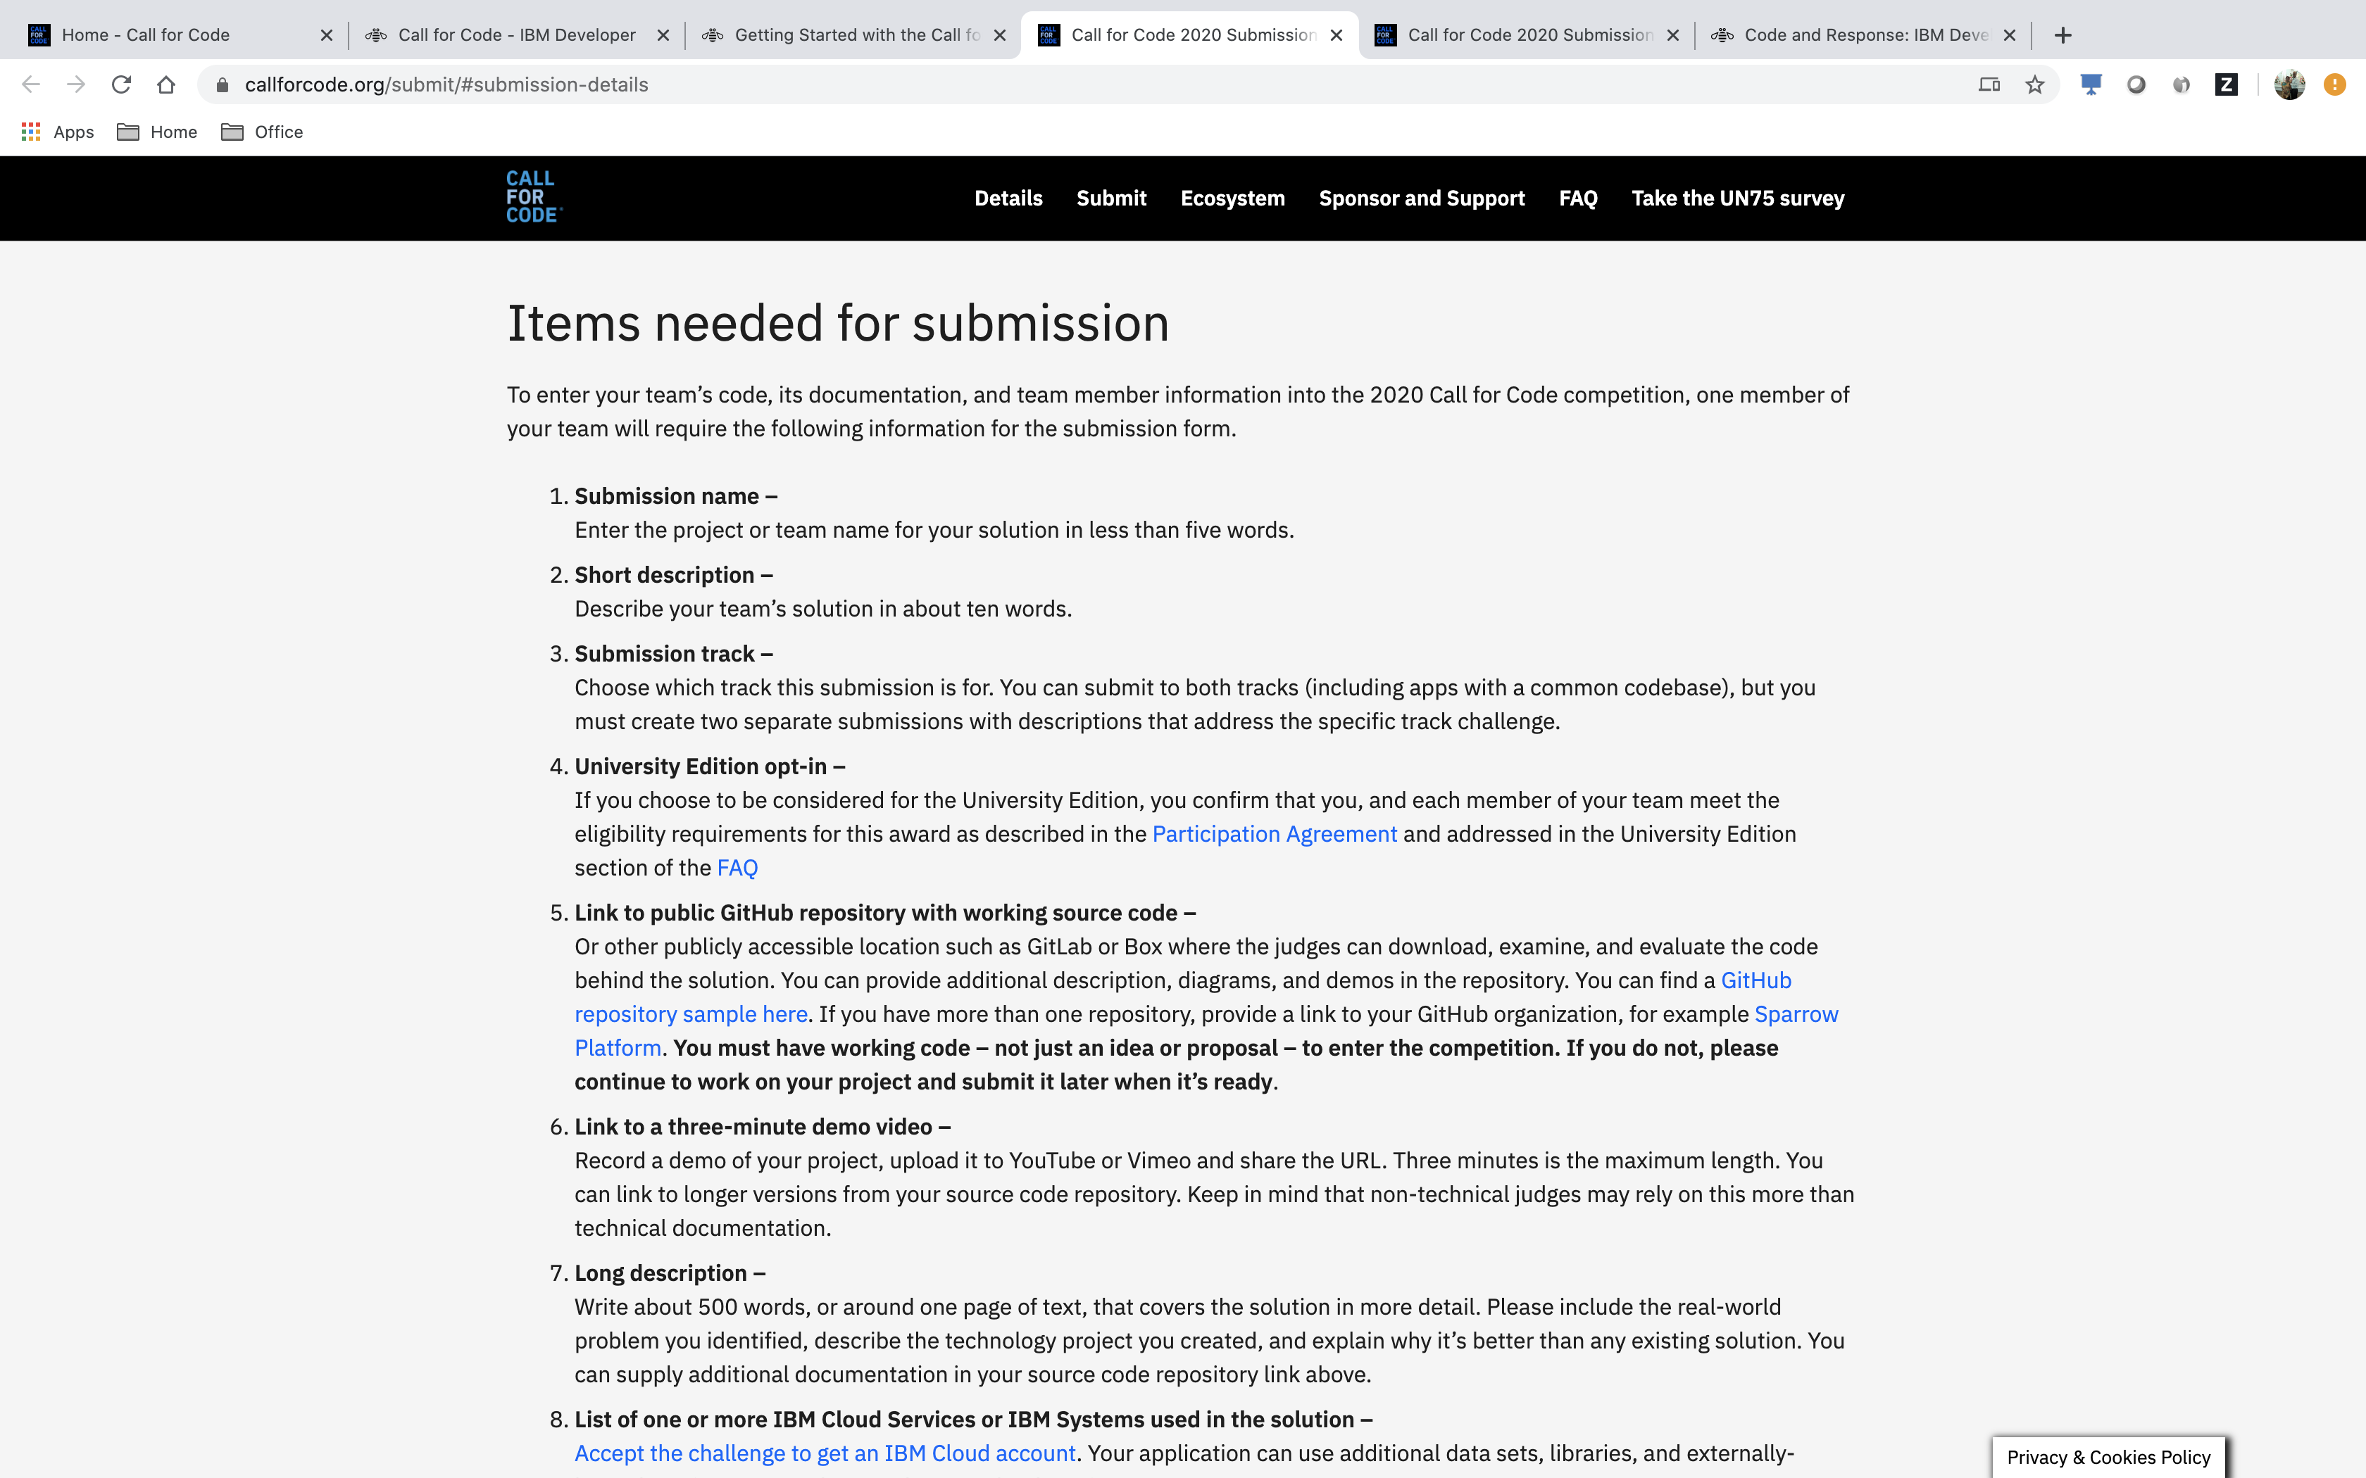
Step 6
Submission details or checklist can be found here –
https://callforcode.org/submit/#submission-details

Slide 34
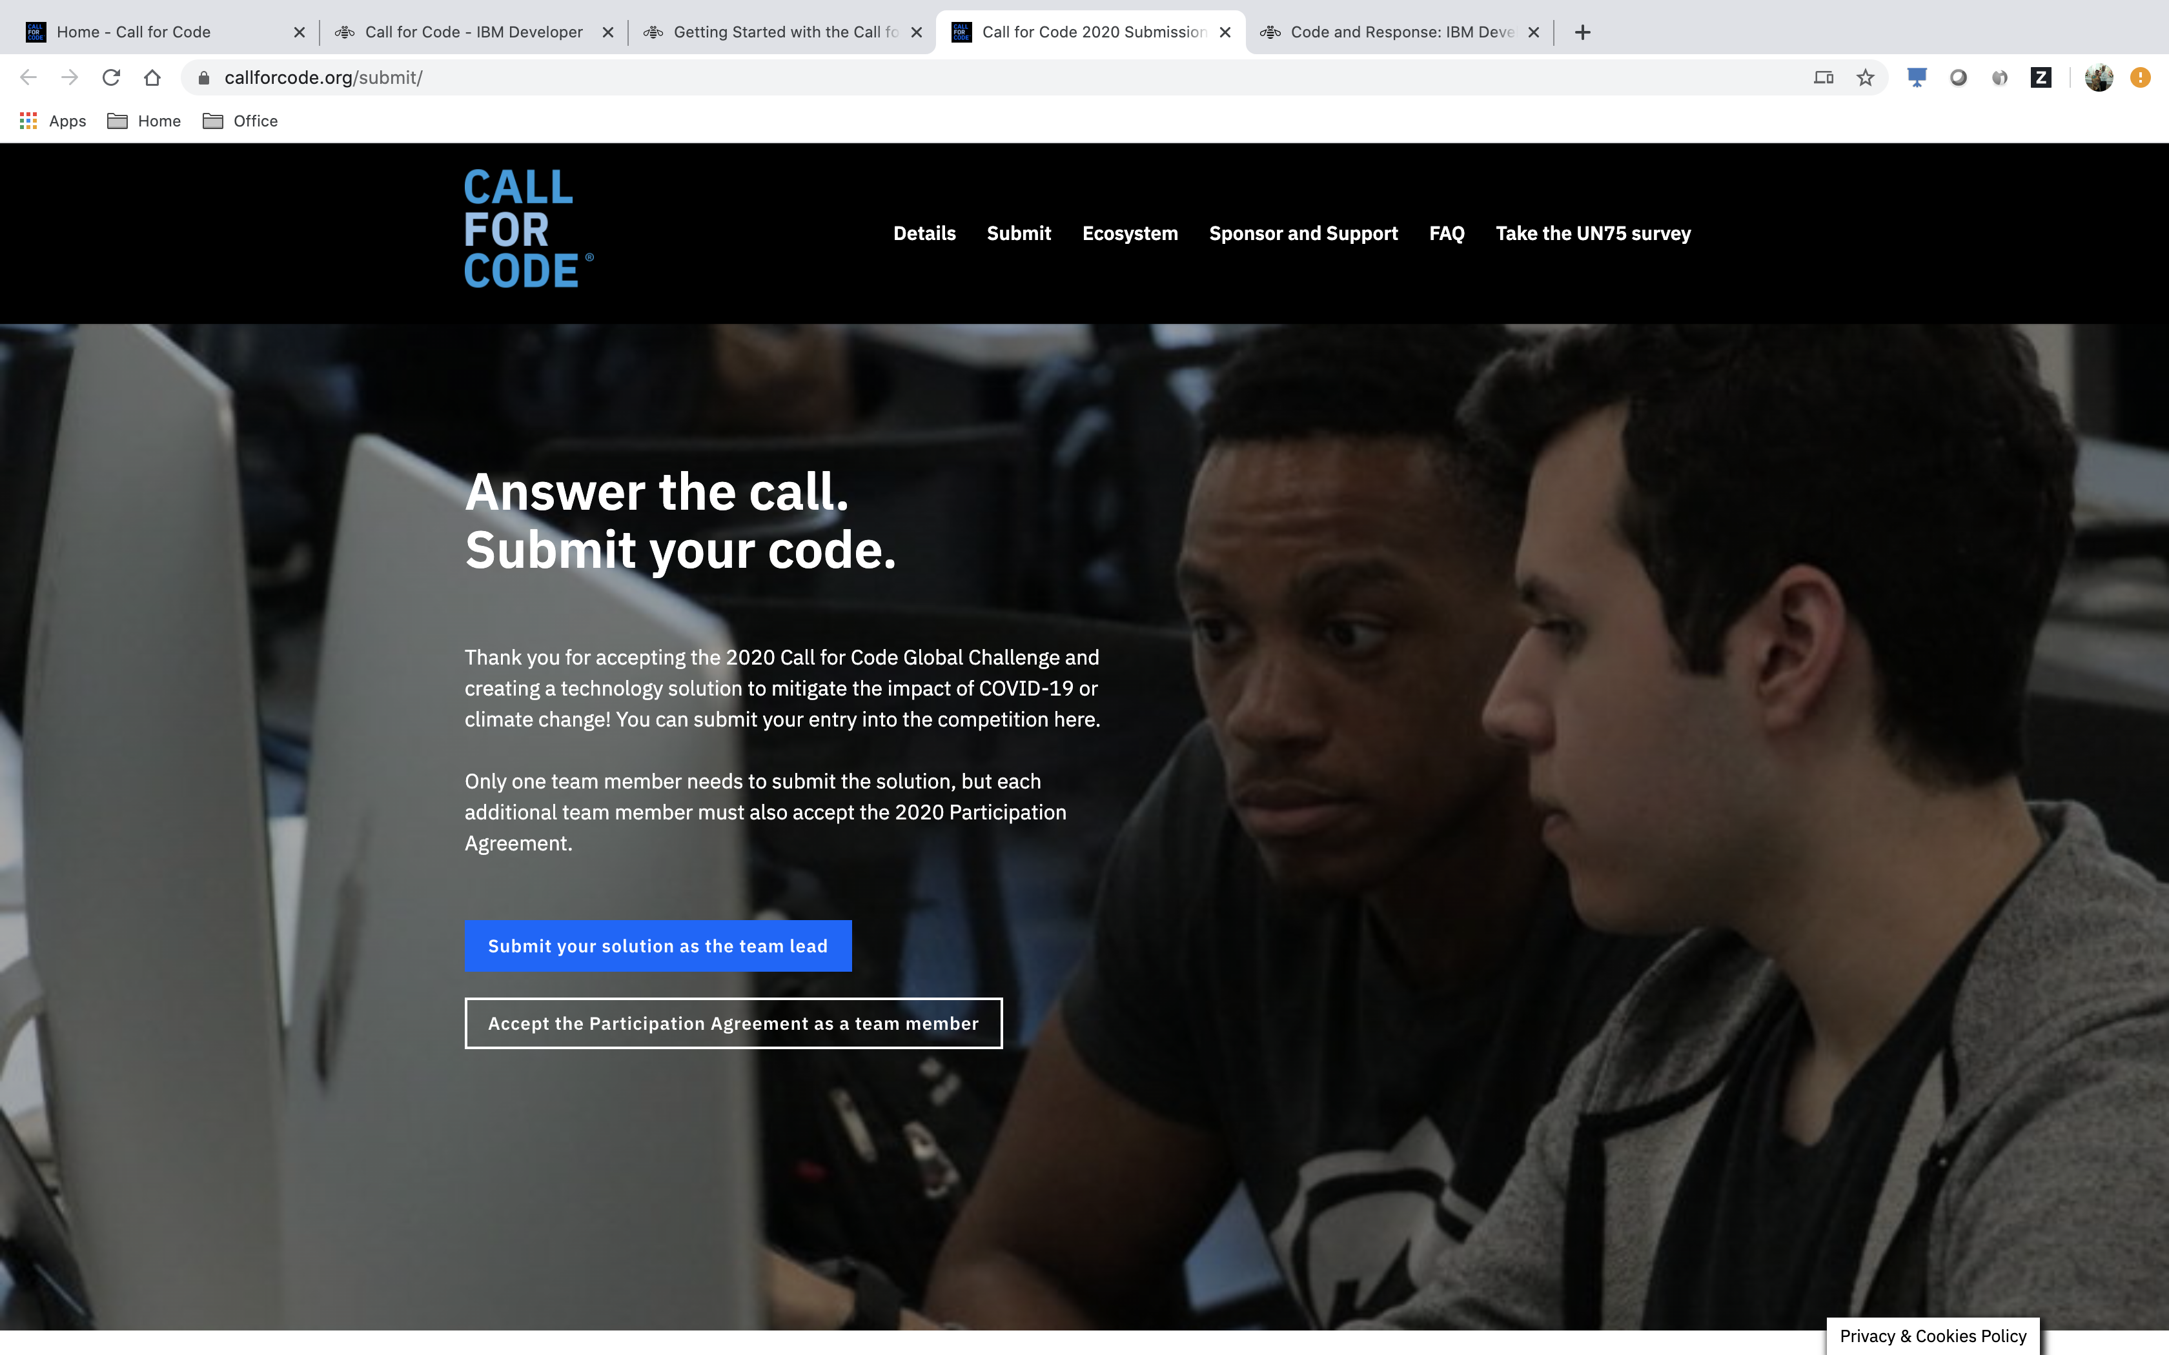
Step 7
Once your solution is ready for submission, click here to submit - https://callforcode.org/submit/
All the participants in a team must accept the Participation Agreement - https://callforcode.typeform.com/to/GvjiTN
Only one participant (for e.g., Team Lead , decide among yourselves, who will be that) in the team can submit your solution - https://callforcode.typeform.com/to/k6UzaA
Complete FAQ - https://callforcode.org/faq/

Slide 35
CFC in one deck

Slide 36


Build solutions that fight back.
Join a movement of:
210,000 developers, data scientists & problem solvers
165+ nations
8,000+ applications built in the prior 2 years
Help seize & reduce the impacts of the COVID-19 pandemic by addressing:
Crisis Communication
Remote Education
Community Cooperation
Help halt & reverse climate change by addressing:
Water sustainability
Energy sustainability
Disaster resiliency
Have the chance to be awarded:
$200,000 USD
Open Source support from The Linux Foundation
Meetings with mentors & potential investors
Solution implementation support through Code and Response™
Register for the challenge and start building
Important links :
Accept the challenge: https://developer.ibm.com/callforcode/
Covid-19 Starter Kits/timelines :
https://developer.ibm.com/callforcode/getstarted/covid-19/
Climate Change Starter Kits/timelines :
https://developer.ibm.com/callforcode/getstarted/climate-change/

